Slide 1

QuickMart Inventory Management System
Team Members: Saugat, Shaikh, Lucas, Ethan, Leena, Gracy, Abdul Course: CIS 370 - System Analysis and Design

Slide 2
Problem Statement & Objectives
QuickMart is a growing retail store struggling with manual inventory management. This has led to stock shortages, over-ordering, and lost revenue due to human error and outdated processes.
Objectives:
Automate stock tracking and updates
Use AI to forecast restocking needs
Streamline and automate purchase orders
Provide real-time reporting for better decisions

Slide 3
Proposed Solution
We propose a web-based Inventory Management System (IMS) that:
Tracks stock levels in real-time
Triggers automatic purchase orders when stock is low
Uses predictive analytics to restock based on past sales trends
Gives users dashboards to monitor all inventory activity

Slide 4

Business & Technical Justification
Business Benefits:
Prevents overstocking and stockouts
Reduces time spent on manual tracking
Enables smarter buying decisions based on real data
Technical Benefits:
Django and PostgreSQL provide secure and scalable backend
React makes the frontend user-friendly and mobile-compatible
Python helps with forecasting and analytics

Slide 5

Prototype Designs
We designed our prototype using Figma and Canva. It includes:
A clean dashboard to show inventory status
Pages for managing stock, orders, and reports
Visual charts and summaries for quick decision-making
Note: Slides 6 and 7 will show the actual screenshots of our prototype designs.

Slide 6
First Prototype

Slide 7
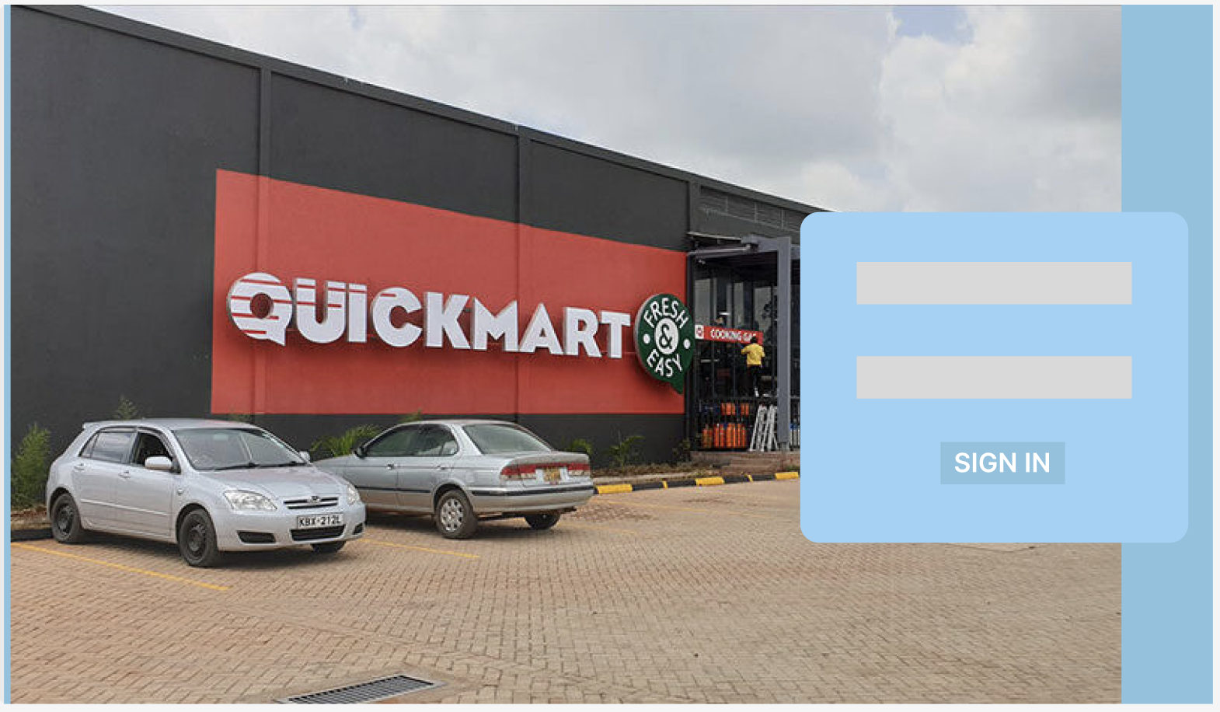

Slide 8
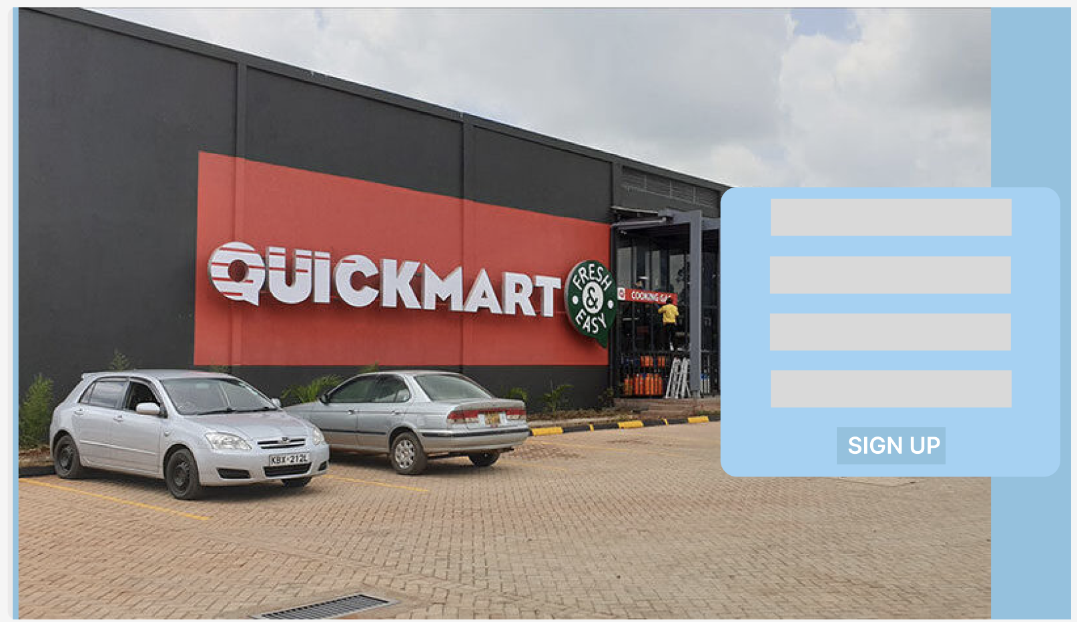

Slide 9
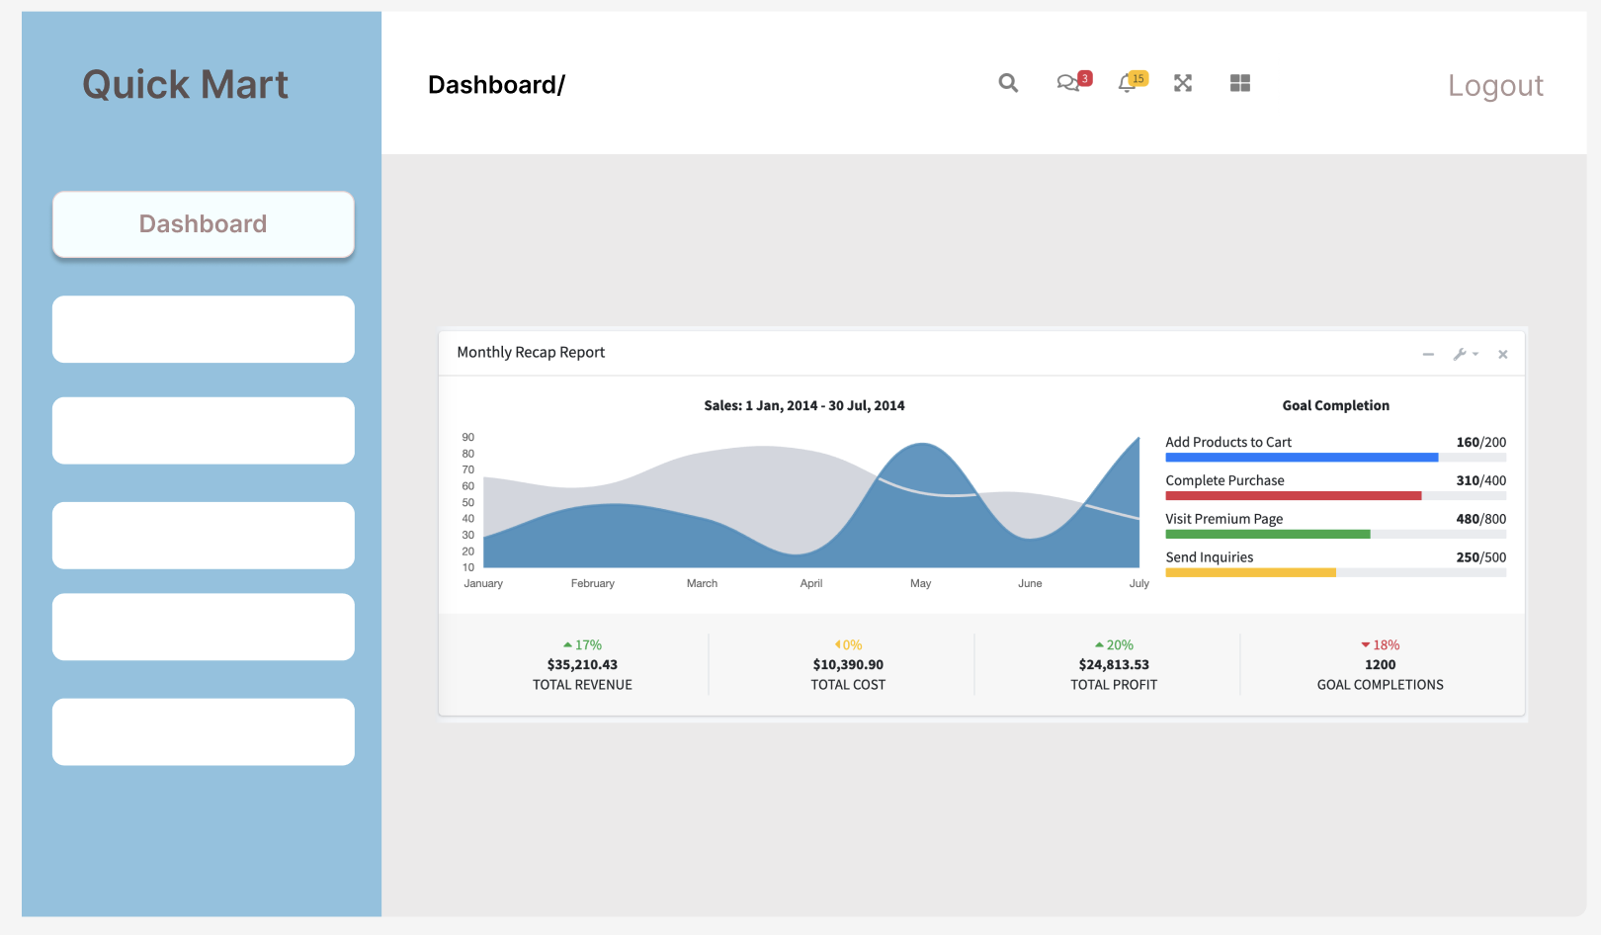

Slide 10
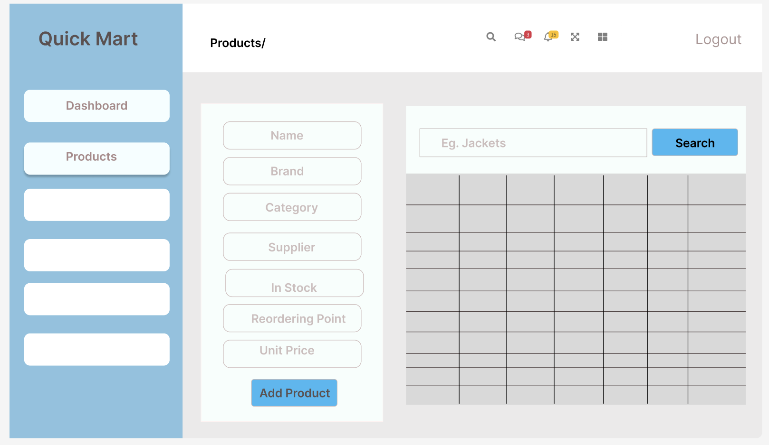

Slide 11
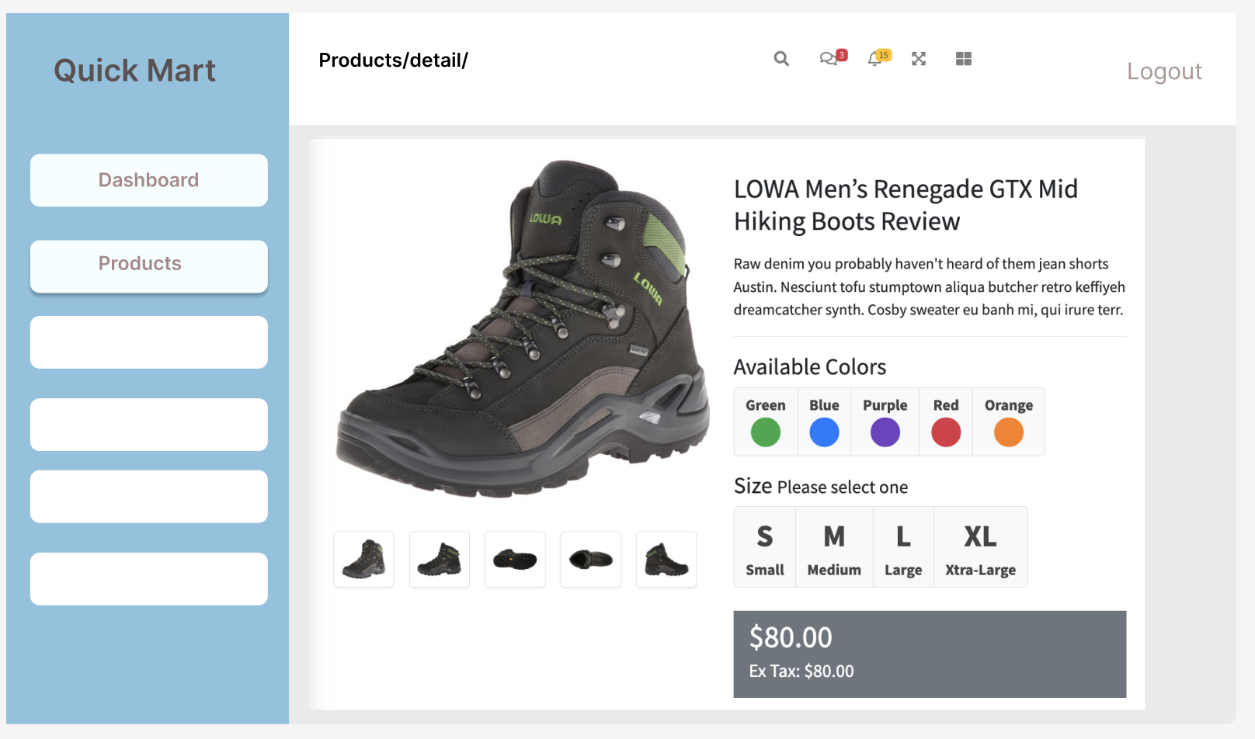

Slide 12
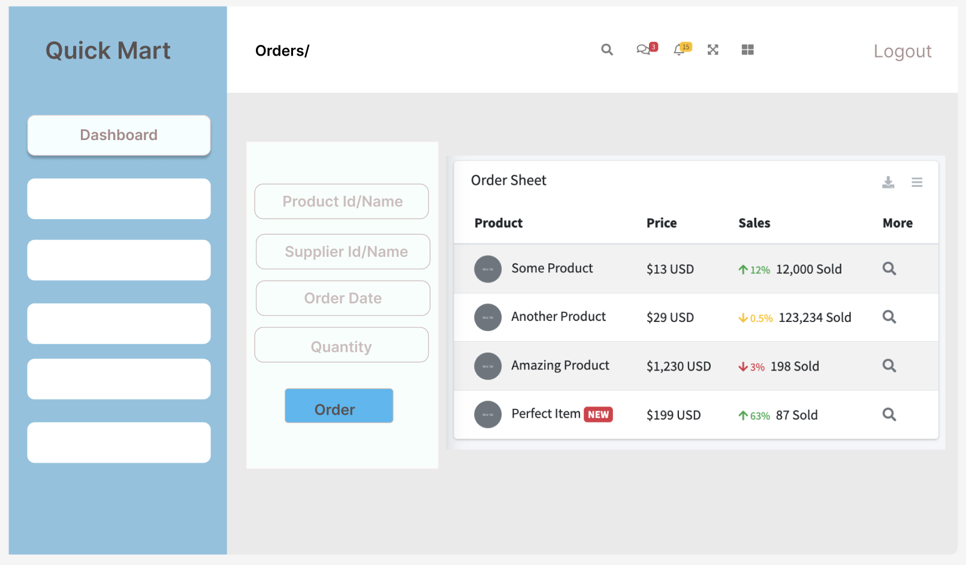

Slide 13
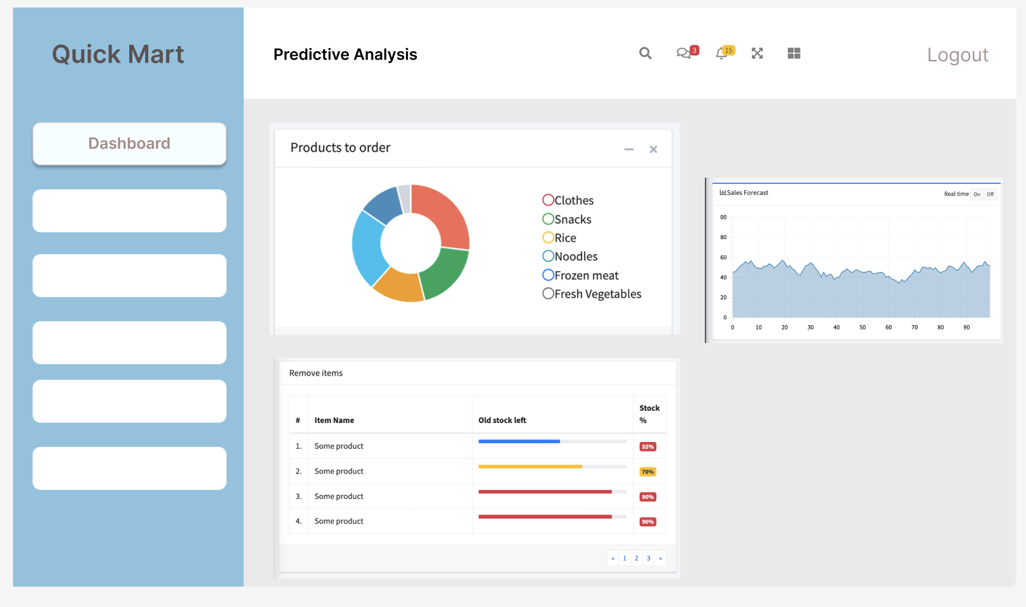

Slide 14
Product prototype feedback

Slide 15
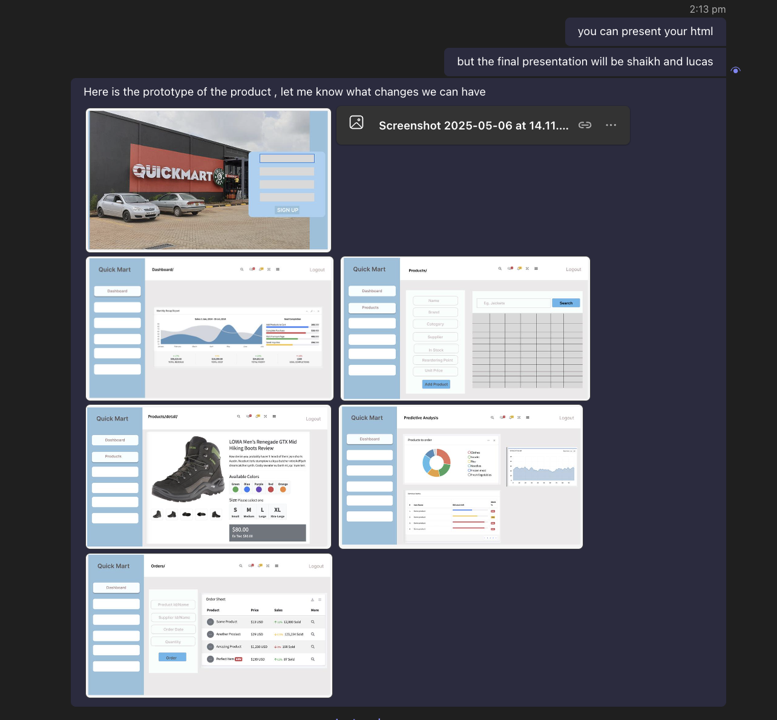

Slide 16
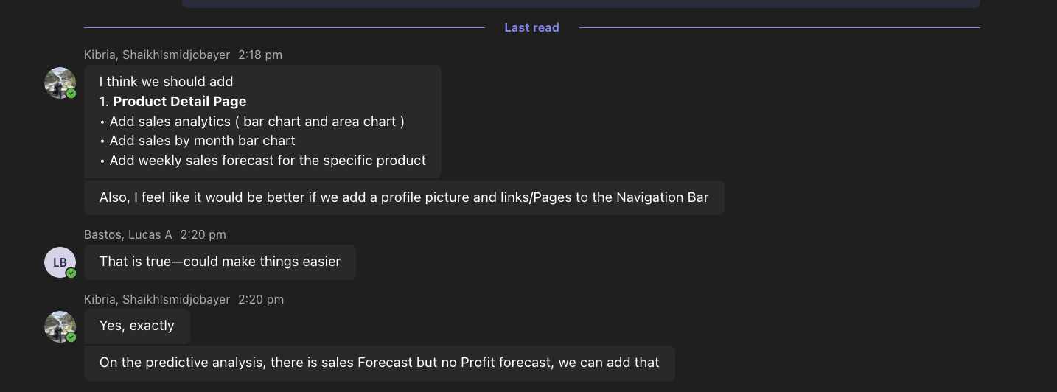

Slide 17
Final Prototype

Slide 20
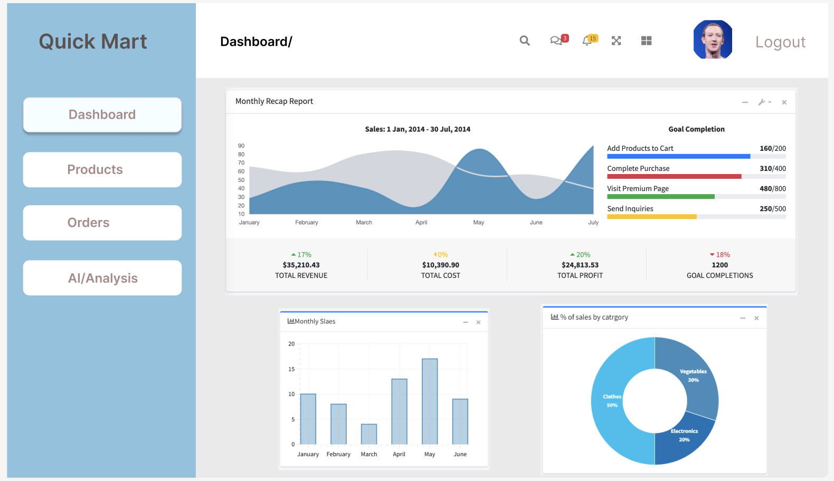

Slide 21
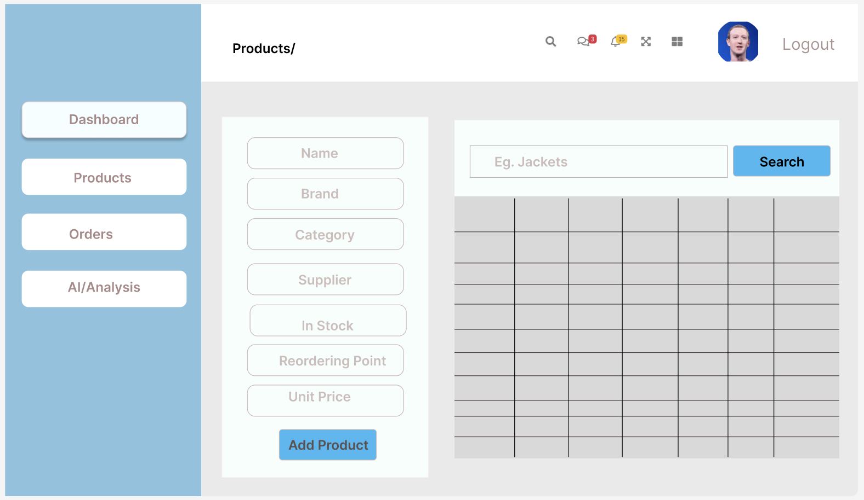

Slide 22
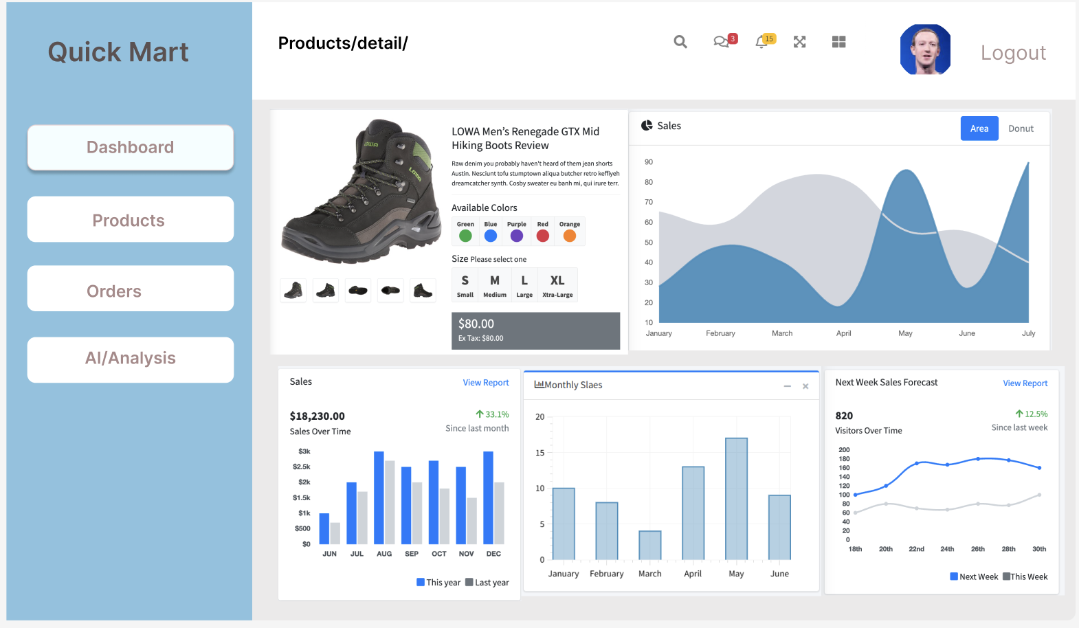

Slide 23
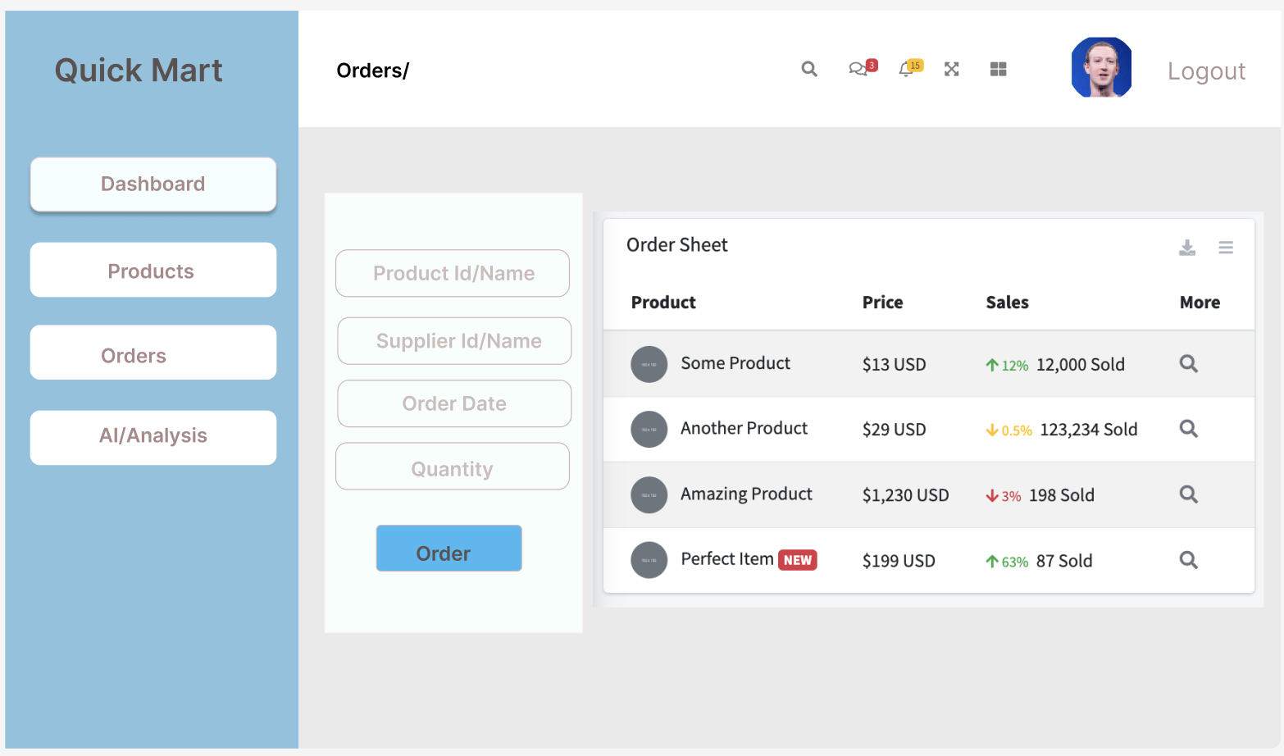

Slide 24
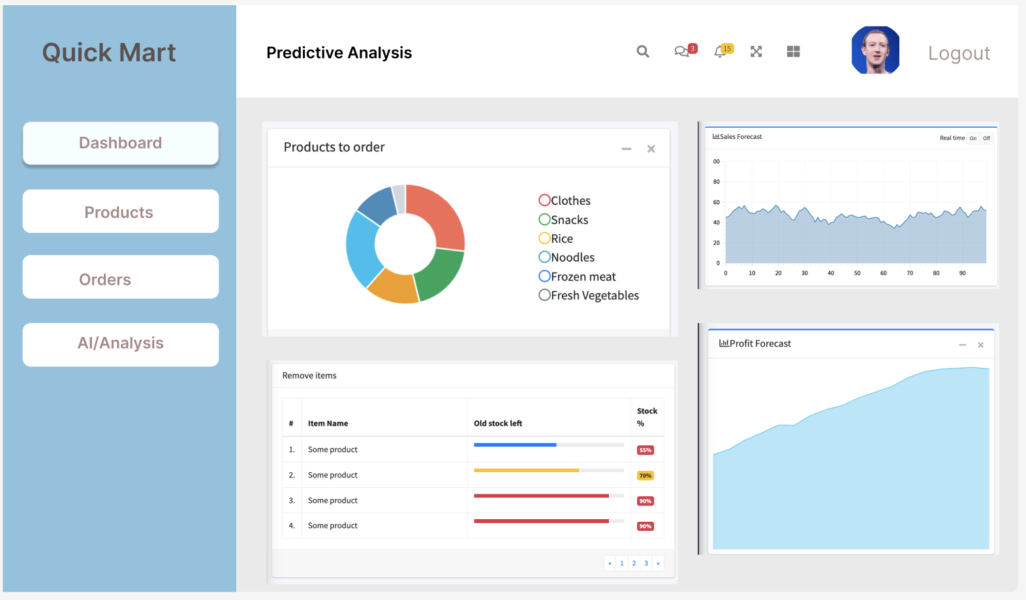

Slide 25

Database Schema
Main tables in our system:
Products: ProductID, Name, Category, StockLevel, ReorderPoint
Orders: OrderID, ProductID, Quantity, Supplier, Status
Sales: SaleID, ProductID, SaleDate, Quantity
Users: UserID, Role, Name, Email
Note: Slides 9 will show the actual screenshots of our ER- Diagram.

Slide 26
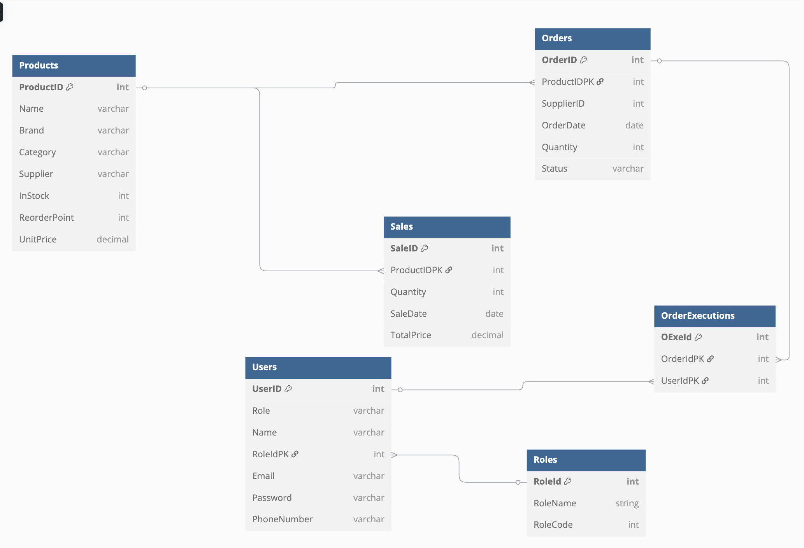

Slide 27
Website Features
Mobile responsive
Role-based access control
Real-time inventory alerts
Integrated graphs and reports

Slide 28

Development Process
Tools: Django, PostgreSQL, React, Python Design: Figma and Canva Team Collaboration: Zoom, Teams Models Created: Level 0 and Level 1 DFD diagrams
Note: Slides 14 and 15 will show the actual screenshots of our Level 0 and Level 1 .

Slide 31
Implementation Plan
Begin rollout in one department
Train staff with live sessions and guides
Migrate old inventory data to system
Use feedback to improve and release next phase

Slide 32
Maintenance Plan
Monitor system logs and errors
Review user feedback weekly
Roll out updates monthly
Schedule data backups and security checks

Slide 33
Roles and Responsibilities
Saugat – Project Manager
Shaikh – Database Administrator
Lucas – Backend Developer
Ethan – Frontend Developer
Leena – AI & Predictive Logic
Gracy – UI/UX Design
Abdul – QA & Documentation

Slide 34
Project Cost Estimate
Project Cost Estimate
Global Tech Solution
1300, Elmwood Ave | 20-Mar-25
Buffalo, NY 14222 | QM-INV-2025-001
www.globaltechsolutions.com | CUST-456
716-2797355, 716-5170919 | 20-Apr-25
Saugat (Project Manager) & Shaikh (Systems Administrator)
Customer
Maria C. Garrity
www.quickmartsolutions.com
456 Retail Street
Los Angeles, CA 90001
(716) 878-3570, hejnamc@buffalostate.edu
Job Description
Development of an AI-powered Inventory Management System with real-time stock tracking, predictive analytics, automated purchase order generation, and web-based accessibility

Slide 35
Planning Phase 1
Phase 1 - Planning and Selection | Labor | Materials | Total | Notes | Materials Details
Meetings and Initial Interviews | $500.00 | $100.00 | $600.00 | Initial project discussions | Conference room booking, documentation materials
Scope and Requirements | $600.00 | $50.00 | $650.00 | Requirements Analysis and Documentation | Requirements Analysis and Documentation
 |  |  | $-
 |  |  | $-
 |  |  | $-
Subtotal | $1,100.00 | $150.00 | $1,250.00
Analysis Phase 2
Phase 2 - Systems Analysis | Labor | Materials | Total | Notes | Materials Details
Technical Interviews and Research | $400.00 | $75.00 | $475.00 | Feasibility analysis | Research Reports and Survey Tools
Application Solution Design | $500.00 | $120.00 | $620.00 | System Architecture and Design | Software design tools, Diagrams
 |  |  | $-
 |  |  | $-
 |  |  | $-
Subtotal | $900.00 | $195.00 | $1,095.00

Slide 36
Design Phase 3 - The design phase focuses on creating the blueprint for the system, including architecture, user interface, database structure, and system specifications.
Phase 3 -Systems Design | Labor | Materials | Total | Notes | Materials Details
Database Development | $600.00 | $100.00 | $700.00 | Tools for schema modeling and ER diagram software | Lucidchart, dbdiagram.io, Postgres tools
Programming | $800.00 | $50.00 | $850.00 | Initial backend design and code scaffolding tools | IDE setup, code libraries
Web Design | $750.00 | $75.00 | $825.00 | UI mockups, Figma/Canva premium, design system assets | Figma subscription, UI templates
Final Prototype | $650.00 | $100.00 | $750.00 | Interactive UI prototype and review | Canva Pro, interactive mockup tools
Testing | $200.00 | $50.00 | $250.00 | Usability testing setup and early feedback collection | Usability tools, design feedback surveys
Subtotal | $3,000.00 | $375.00 | $3,375.00
Implementation Phase 4 - This is where the actual development and coding of the system takes place, based on the design specifications.
Phase 4 - Implementation | Labor | Materials | Total | Notes | Materials Details
Complete Training | $600.00 | $100.00 | $700.00 | Internal team training on deployed system | Training manuals, Zoom/Teams resources
Convert Data, Prep Production Environment | $1,000.00 | $150.00 | $1,150.00 | Finalize database, migrate from test to live | Cloud hosting, deployment scripts
Systen Integration | $1,200.00 | $100.00 | $1,300.00 | Connect frontend/backend, test connectivity | API keys, integration services
AI model Integration | $1,200.00 | $50.00 | $1,250.00 | Link predictive restocking with live database | Python libraries, GPU cloud runtime
Final Debugging and Bug Fixing | $600.00 | $50.00 | $650.00 | Resolve major bugs, validate transactions | Bug tracking tools, testing environment
Subtotal | $4,600.00 | $450.00 | $5,050.00

Slide 37
Operations Phase 5 - After the system is deployed, the maintenance and operations phase focuses on addressing any issues, providing updates, and ensuring the system continues to meet user needs.
Phase 5 - Operation and Maintenance | Labor | Materials | Total | Notes | Materials Details
Complete Training | $500.00 | $75.00 | $575.00 | Traning Slides, LMS tools | Training manuals, Zoom/Teams resources
Monitor System Logs | $700.00 | $50.00 | $750.00 | Logging Dashboard, tools | Cloud hosting, deployment scripts
Apply Updates and Patches | $600.00 | $40.00 | $640.00 | Version Control tools, Patch Deployment Scripts | API keys, integration services
Address User Support & Feedback | $500.00 | $35.00 | $535.00 | Support Desk Software, Feedback forms | Python libraries, GPU cloud runtime
Subtotal | $2,300.00 | $200.00 | $2,500.00
 |  |  | $-
Grand Total | $5,000.00 | $720.00 | $13,270.00

Slide 38
Project Duration & Critical Path Analysis
Total Project Duration: The project started on March 1, 2025, and the last recorded session was on March 20, 2025, making the total duration 19 days.
Critical Path Analysis:
Task | Description | Duration (Days) | Depend On
A | Planning & Requirement Gathering | 5 | -
B | System Design & Database Setup | 6 | A
C | Backend & Frontend Development | 10 | B
D | AI Model Development | 7 | B
E | Testing & Quality Assurance | 5 | C, D
F | Deployment & Documentation | 4 | E
G | Project Completion | 1 | F
Path Durations
1. A → B → C → E → F → G = 5 + 6 + 10 + 5 + 4 + 1 = 31 days
2. A → B → D → E → F → G = 5 + 6 + 7 + 5 + 4 + 1 = 28 days
Final Answer:
Critical Path: A → B → C → E → F → G (31 days)
This is the longest and most essential sequence of tasks. If any task in this path is delayed, the entire project will be delayed.
Tasks like AI Model Development (D) can be delayed slightly as long as they don’t exceed 31 days before Testing (E) starts.

Slide 39
Conclusion
QuickMart’s new Inventory Management System will reduce errors, save time, and help the store make smarter business decisions. With automation, AI forecasting, and real-time reporting, QuickMart is ready to grow with confidence

Slide 40

Thank You

